Slide 1
ALGEBRA

Slide 2

RATIO AND PROPORTION
Q 1.

Slide 3
RATIO AND PROPORTION
Q 1.
ANSWER:- d

Slide 4

Q 2.

Slide 5
Q 2.
ANSWER:- b

Slide 6
Q 3.

Slide 7
Q 3.
ANSWER:- b

Slide 8

Q 4. If then

Slide 9
Q 4. If then
1
2
4
-2
ANSWER:- d

Slide 10

Q 5. If find the value of

Slide 11
Q 5. If find the value of
2
4
6
8
ANSWER:- b

Slide 12


Algebra VIDEO-1
Q:6. If then find the value of
115
112
100
55

Slide 13
Algebra VIDEO-1
Q:6. If then find the value of
115
112
100
55
ANSWER:- a

Slide 14


Algebra VIDEO-1
Q:7 . If then find the value of 1
223/3
220/3
100
284/3

Slide 15
Algebra VIDEO-1
Q:7 . If then find the value of 1
223/3
220/3
100
284/3
ANSWER:- a

Slide 16


Algebra VIDEO-1
Q:8. If , , then the value of is
1
2
5
10

Slide 17
Algebra VIDEO-1
Q:8. If , , then the value of is
1
2
5
10
ANSWER:- d

Slide 18
ALGEBRA VIDEO-1
Q: 9. Find the maximum value of the expression (p²+7p+13)⁻¹.
a) 5/7
b) 4/3
c) 20
d) 3/7

Slide 19
ALGEBRA VIDEO-1
Q: 9. Find the maximum value of the expression (p²+7p+13)⁻¹.
5/7
b) 4/3
c) 20
d) 3/7
ANSWER:- b

Slide 20
ALGEBRA VIDEO-1
Q:10. Find the values of x where the quadratic expression
2x² - 3x + 5 (x ϵ R) reaches a minimum value. Also find the minimum value?
31/8
11/3
12/5
None

Slide 21
ALGEBRA VIDEO-1
Q:10. Find the values of x where the quadratic expression
2x² - 3x + 5 (x ϵ R) reaches a minimum value. Also find the minimum value?
31/8
11/3
12/5
None
ANSWER:- a

Slide 22
ALGEBRA VIDEO-1
Q:11. Find the Maximum/Minimum Value f(x) = x² – 4x + 2
Min 2
Max 3
Min 3
Min -2

Slide 23
ALGEBRA VIDEO-1
Q:11. Find the Maximum/Minimum Value f(x) = x² – 4x + 2
Min 2
Max 3
Min 3
Min -2
ANSWER:- d

Slide 24
ALGEBRA VIDEO-1
Q:12. The minimum value of (x-2)(x-9) is:
-11/4
b) 49/4
c) 0
d) - 49/4

Slide 25
ALGEBRA VIDEO-1
Q:12. The minimum value of (x-2)(x-9) is:
-11/4
b) 49/4
c) 0
d) - 49/4
ANSWER:- d

Slide 26

Algebra VIDEO-1
Q:13. If than find the value of
1
2
10
0

Slide 27
Algebra VIDEO-1
Q:13. If than find the value of
1
2
10
0
ANSWER:- d

Slide 28

Algebra VIDEO-1
Q:14. If than find the value of
1
2
3
4

Slide 29
Algebra VIDEO-1
Q:14. If than find the value of
1
2
3
4
ANSWER:- b

Slide 30
Algebra VIDEO-1
Q:15.If then find the value of
2
3
8
6

Slide 31
Algebra VIDEO-1
Q:15.If then find the value of
2
3
8
6
ANSWER:- d

Slide 32

Algebra VIDEO-1
Q:16.If then what is the value of
a) 0
b) 1
c) 2
d)

Slide 33
Algebra VIDEO-1
Q:16.If then what is the value of
a) 0
b) 1
c) 2
d)
ANSWER:- b

Slide 34
Algebra VIDEO-1
Q:17. If than find the value of
a)
b)
c)
d) None of these

Slide 35
Algebra VIDEO-1
Q:17. If than find the value of
a)
b)
c)
d) None of these
ANSWER:- b

Slide 36

Algebra VIDEO-1
Q:18.
a).
b).
c).
d).

Slide 37
Algebra VIDEO-1
Q:18.
a).
b).
c).
d).
ANSWER:- b

Slide 38

Algebra VIDEO-1
Q:19If then the value of is
a)
b)
c)
d) 1

Slide 39
Algebra VIDEO-1
Q:19If then the value of is
a)
b)
c)
d) 1
ANSWER:- c

Slide 40
Algebra VIDEO-1
Q:20.If then find the value of
22
34
37
none

Slide 41
Algebra VIDEO-1
Q:20.If then find the value of
22
34
37
none
ANSWER:- d

Slide 42
Algebra VIDEO-1
Q:21.If than
a)
b) 3
c)
d) 3

Slide 43
Algebra VIDEO-1
Q:21.If than
a)
b) 3
c)
d) 3
ANSWER:- a

Slide 44
Algebra VIDEO-1
Q:22. If then the value of
is equal to :
a)
b)
c)
d)

Slide 45
Algebra VIDEO-1
Q:22. If then the value of
is equal to :
a)
b)
c)
d) ANSWER:- c

Slide 46
Algebra VIDEO-1
Q:23.

Slide 47
Algebra VIDEO-1
Q:23.
ANSWER:- d

Slide 48

Algebra VIDEO-1
Q:24 .

Slide 49
Algebra VIDEO-1
Q:24 .
ANSWER:- b

Slide 50

Algebra VIDEO-1
Q:25.

Slide 51
Algebra VIDEO-1
Q:25.
ANSWER:- b

Slide 52

Algebra VIDEO-1
Q:26.

Slide 53
Algebra VIDEO-1
Q:26.
ANSWER:- a

Slide 54
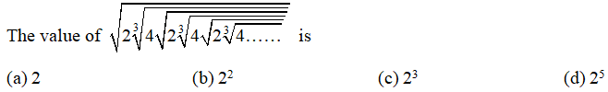
Algebra VIDEO-1
Q:27.

Slide 55
Algebra VIDEO-1
Q:27.
ANSWER:- a

Slide 56


Algebra VIDEO-1
Q:28.If then
1
(b) 2
(c) 3
(d) 4

Slide 57
Algebra VIDEO-1
Q:28.If then
1
(b) 2
(c) 3
(d) 4
ANSWER:- b

Slide 58

Algebra VIDEO-1
Q:29. If than find the value of x ?
1/5
(b) 12/5
(c) 3/5
(d) 4/5

Slide 59
Algebra VIDEO-1
Q:29. If than find the value of x ?
1/5
(b) 12/5
(c) 3/5
(d) 4/5
ANSWER:- b

Slide 60


Algebra VIDEO-1
Q:30. if and than
find the value of
125
256
230
None of these

Slide 61
Algebra VIDEO-1
Q:30. if and than
find the value of
125
256
230
None of these
ANSWER:- d

Slide 62
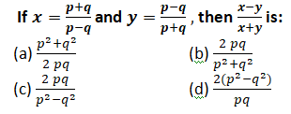
Algebra VIDEO-1
Q:31.

Slide 63
Algebra VIDEO-1
Q:31.
ANSWER:- b

Slide 64
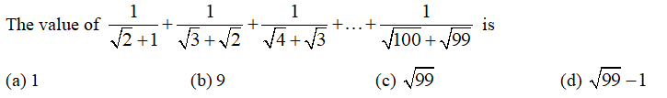
Algebra VIDEO-1
Q:32.

Slide 65
Algebra VIDEO-1
Q:32.
ANSWER:- b

Slide 66

Algebra VIDEO-1
Q:33.

Slide 67
Algebra VIDEO-1
Q:33.
ANSWER:- a

Slide 68

Algebra VIDEO-1
Q:34.
20
10
2
none
= ?

Slide 69
Algebra VIDEO-1
Q:34.
20
10
2
none
ANSWER:- a
= ?

Slide 70

Algebra VIDEO-1
Q:35.
2
3
none
6

Slide 71
Algebra VIDEO-1
Q:35.
2
3
none
6
ANSWER:- c

Slide 72
Algebra VIDEO-1
Q:36. A complete factor form of
a.
b.
c.
d. None of these.

Slide 73
Algebra VIDEO-1
Q:36. A complete factor form of
a.
b.
c.
d. None of these.
ANSWER:- c

Slide 74
Algebra VIDEO-1
Q:37. if x – y= 2, xy= 24, than what will be the value of ?
24
25
50
52

Slide 75
Algebra VIDEO-1
Q:37. if x – y= 2, xy= 24, than what will be the value of ?
24
25
50
52
ANSWER:- d

Slide 76
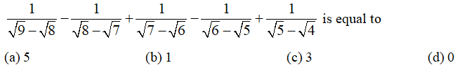
Algebra VIDEO-1
Q:38.

Slide 77
Algebra VIDEO-1
Q:38.
ANSWER:-B

Slide 78

Algebra VIDEO-1
Q:39.
1000
200
1100
200

Slide 79
Algebra VIDEO-1
Q:39.
1000
200
1100
200
ANSWER:- c

Slide 80

Algebra VIDEO-1
Q:40.If and then the value of is.
1
2
3
4

Slide 81
Algebra VIDEO-1
Q:40.If and then the value of is.
1
2
3
4
ANSWER:- c

Slide 82
Algebra
Q:41- Find the remainder (without division) when x² + 7x -11 is divisible by (3x - 2) ?
- 53/9
30
20
NONE

Slide 83
Q.41-
- 53/9
30
20
NONE
ANSWER:- a

Slide 84
Algebra
Q:42- If the polynomials ax³ + 4x² + 3x -4 and x3 -4x + a leave the dame remainder when divided by (x - 3), find the value of a?
1
-1
2
-2

Slide 85
Q.42-
1
-1
2
-2
ANSWER:- b

Slide 86
Algebra
Q:43- Find the value of k if the remainder is -3 when kx³ + 8x² – 4x + 10 id divided by x + 1 ?
12
10
25
5

Slide 87
Q.43-
12
10
25
5
ANSWER:- c

Slide 88
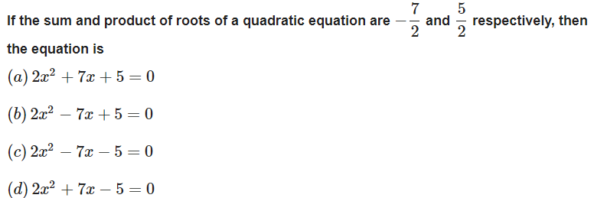
Algebra
Q.44-

Slide 89
Q.44-
ANSWER:- a

Slide 90
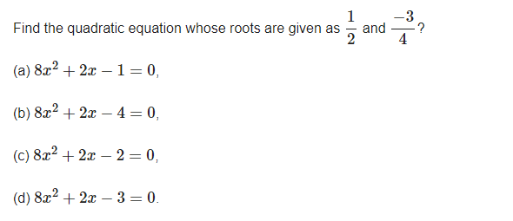
Q.45-

Slide 91
Q.45-
ANSWER:-d

Slide 92
Q.46-
3/5
5/6
3/8
none

Slide 93
Q.46-
3/5
5/6
3/8
None
ANSWER:- a

Slide 94
Q.47- Find a polynomial equation of minimum degree with rational coefficients, having 2 + √3 i as a root.
x2 – 4x + 7 = 0
x3 – 4x + 7 = 0
x2 – 4x + 9 = 0
none

Slide 95
Q.47- Find a polynomial equation of minimum degree with rational coefficients, having 2 + √3 i as a root.
x2 – 4x + 7 = 0
x3 – 4x + 7 = 0
x2 – 4x + 9 = 0
None
ANSWER:- a

Slide 96
THANK YOU

